Slide 1
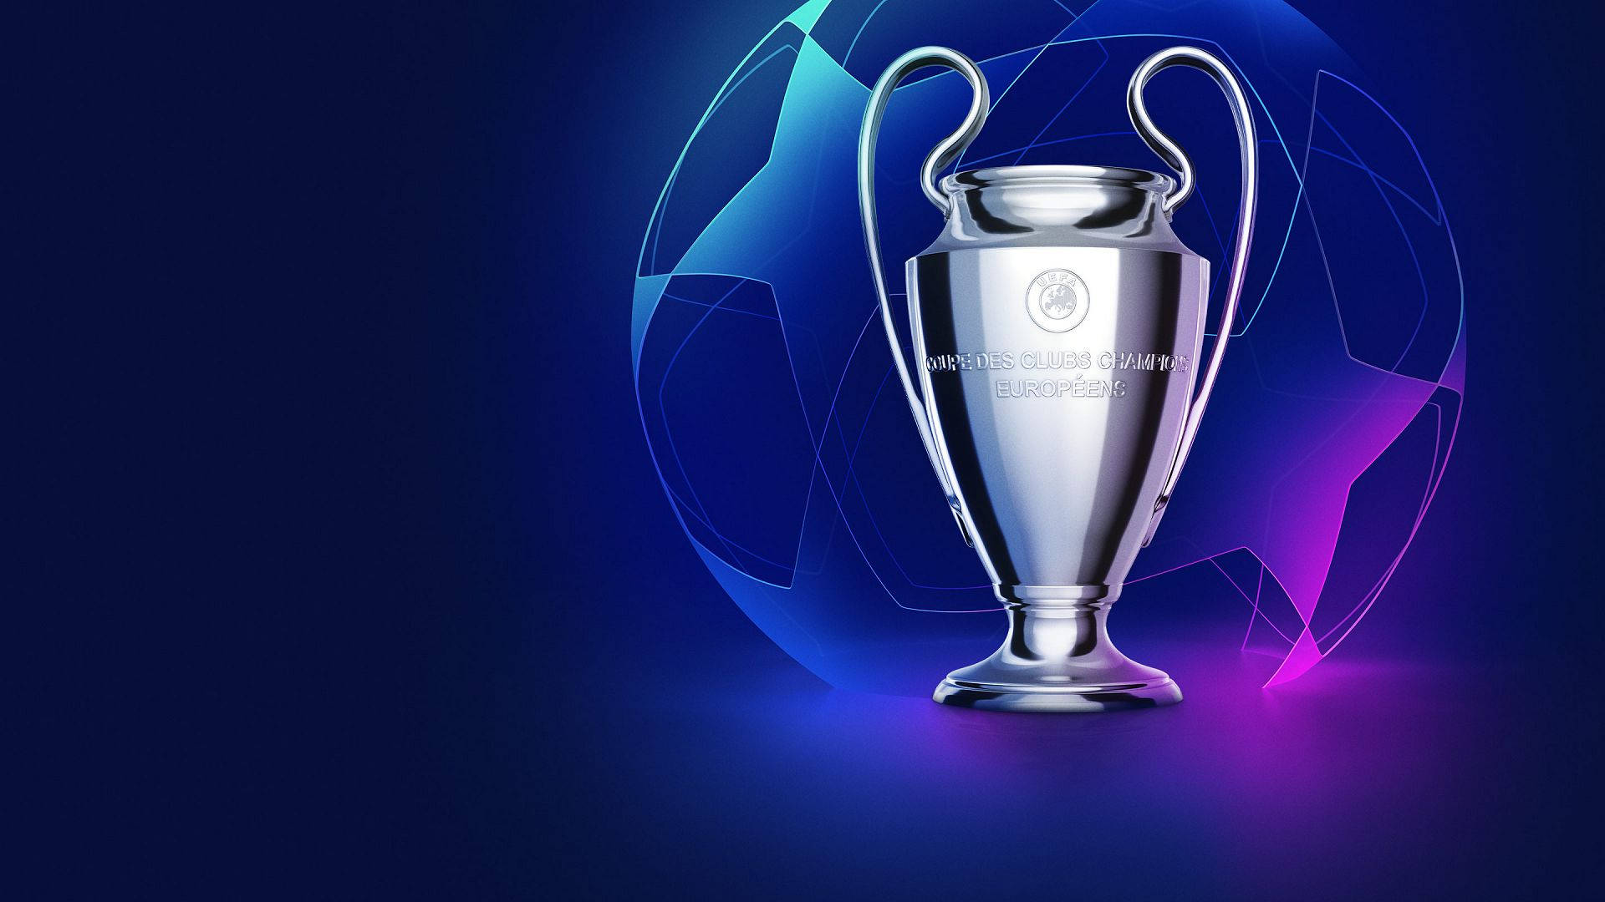

The History of UEFA Champions League
Ali Cagan Sanli – s26942

Slide 2
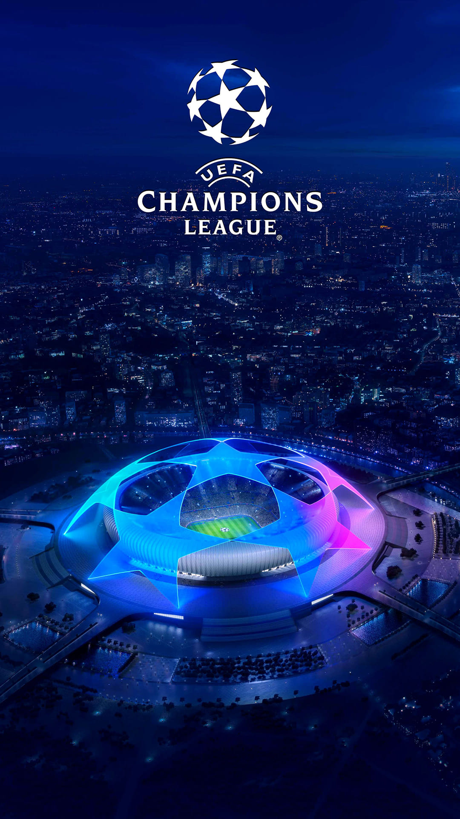
Introduction
The UEFA Champions League is the most prestigious club football competition in Europe, captivating fans worldwide. It has a rich history, evolving from the European Cup to the global spectacle it is today.
Known for its electrifying atmosphere and showcasing the world's best talent, the tournament is a stage where legends are born and unforgettable moments are created.
From dramatic comebacks to iconic goals, the Champions League epitomizes the spirit of football. Its anthem alone has become synonymous with greatness, stirring excitement in fans and players alike.

Slide 3
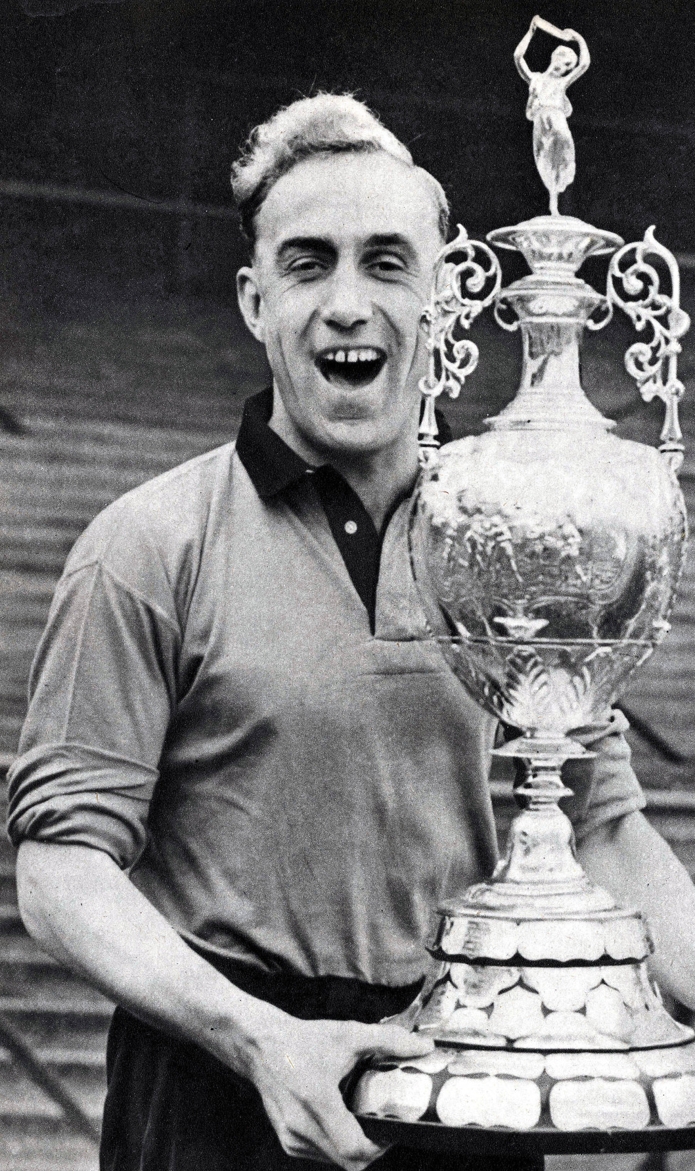
Origins (1955-1992)
The competition began in 1955 as the European Cup, founded by UEFA and Gabriel Hanot, inspired by the need to crown the best club team in Europe.
Early years saw Real Madrid dominate with 5 consecutive titles from 1956 to 1960, solidifying their status as one of the greatest teams in football history.
The tournament initially featured only league champions, creating an elite competitive atmosphere.
The European Cup became renowned for iconic matches and historic rivalries, laying the foundation for the global appeal of the modern Champions League.

Slide 4
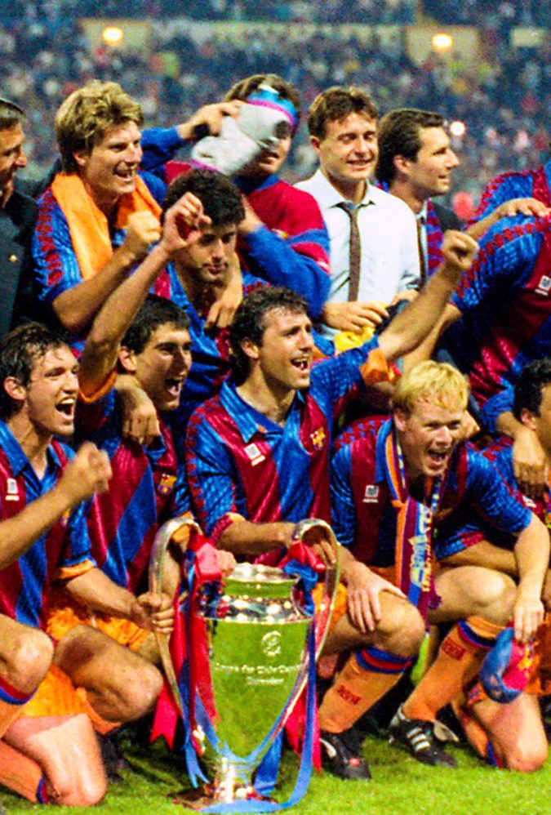

Transition to Champions League (1992)
Rebranded in 1992, the UEFA Champions League was introduced to expand the competition's global appeal and modernize European club football.
The new format included a group stage, allowing teams to play multiple matches against different opponents, increasing excitement and competition.
Participation was also extended beyond just domestic league champions, enabling more clubs from top leagues to compete, reflecting the growing depth of European football.

Slide 5
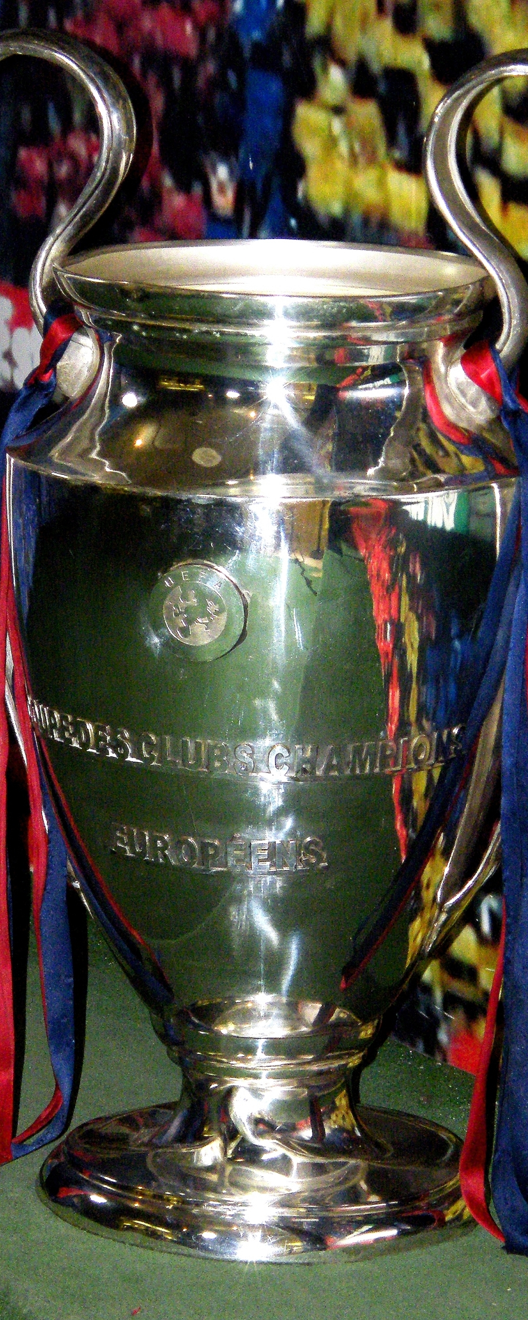
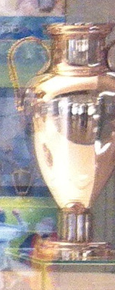
Transition to Champions League (1992)
A redesigned trophy was unveiled, symbolizing the prestige of the updated competition.
The transition marked a turning point, boosting the tournament’s television appeal, sponsorship opportunities, and international fanbase, transforming it into a global phenomenon.
Iconic moments from this era include the rise of clubs like AC Milan, Barcelona, and Manchester United, as well as unforgettable matches that captivated audiences worldwide.

Slide 6
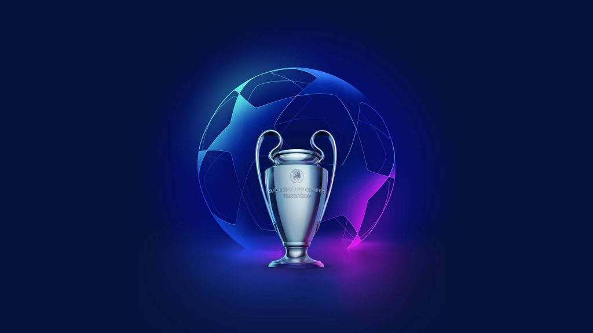
Records and Statistics
Club Records
Most Titles:
Real Madrid – 15 Titles
Most Consecutive Titles:
Real Madrid – 5 consecutive titles (1956–1960).
Biggest Win in a Match:
Liverpool 8–0 Beşiktaş
(2007–08 group stage).
Most Goals in a Single Season (Team):
Barcelona – 45 goals (1999–2000 season).
Individual Records
Most Goals in Champions League History:
Cristiano Ronaldo – 140+ goals.
(h.m : Lewandowski has 99)
Most Goals in a Single Season:
Cristiano Ronaldo – 17 goals (2013–14 season).
Most Appearances:
Iker Casillas – 177 matches.
Fastest Hat-Trick:
Bafétimbi Gomis – 8 minutes (Lyon vs. Dinamo Zagreb, 2011).

Slide 7
Memorable Finals
Iconic matches include Manchester United vs. Bayern Munich (1999), Liverpool vs. AC Milan (2005), and Real Madrid's 'La Décima' win in 2014.

Slide 8
Iconic Players and Coaches
Players: Messi, Ronaldo, Zidane, Maldini.
Coaches: Sir Alex Ferguson, Carlo Ancelotti, Pep Guardiola.

Slide 9
Impact on Football
The Champions League has transformed club football, influencing economics, uniting fans globally, and driving player transfers.

Slide 10
Modern-Day Competition
The current format features group stages and knockout rounds, showcasing the best teams and players from Europe and beyond.

Slide 11
Challenges and Controversies
Financial dominance by elite clubs, the Super League proposal, and VAR controversies are some of the challenges facing the competition.

Slide 12
Key Milestones
The competition evolved over time, introducing group stages, changing qualification rules, and expanding to include more teams from various leagues.

Slide 13
Future of the Champions League
Planned format changes, including the Swiss model, aim to enhance competition. UEFA envisions continued global growth and appeal.

Slide 14
Fun Facts and Trivia
First goal scorer: João Baptista Martins.
Most hat-tricks: Messi and Ronaldo.
Countries with the most winners: Spain, England, and Italy.

Slide 15
Conclusion
The UEFA Champions League has evolved into a global spectacle, capturing the hearts of football fans and shaping the sport's future.

Slide 16
Q&A
Thank you! Any questions?

